Slide 1
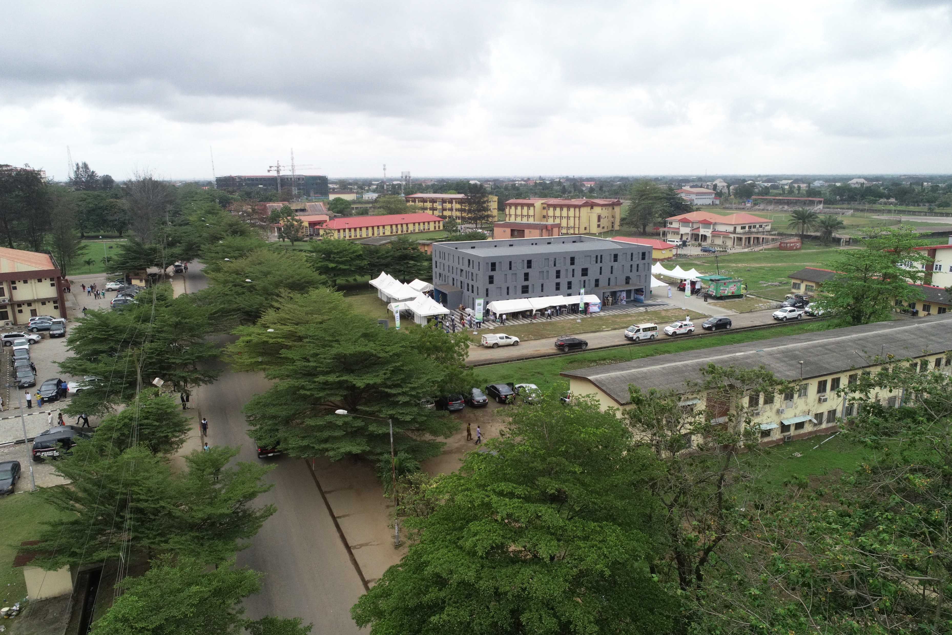

LAGOS STATE
LASU COVID-19
Public Lecture Series
UNIVERSITY

Slide 2

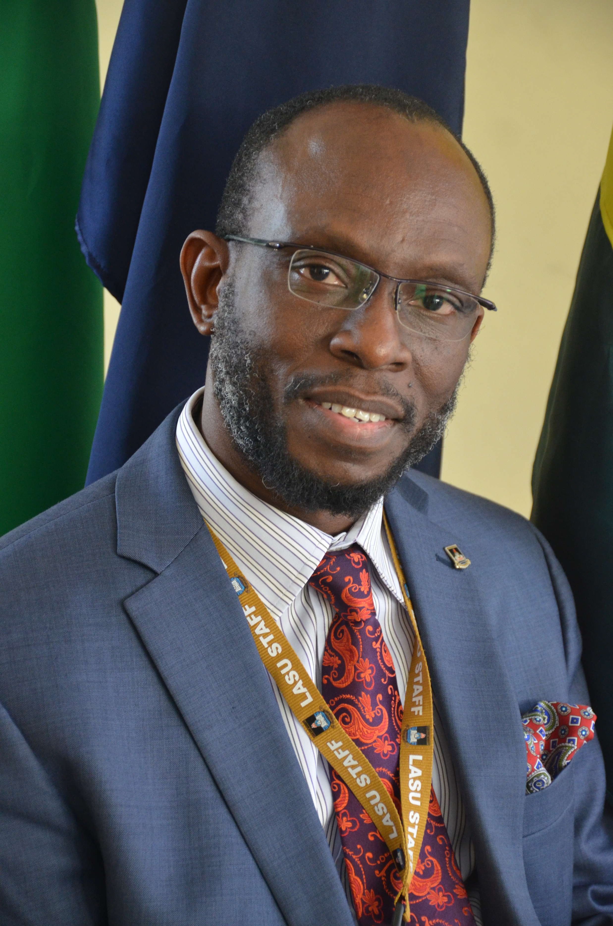
Chairman
Professor Olanrewaju A. FAGBOHUN PhD, SAN
National Productivity Merit Award Winner, 2019
Vice Chancellor
Lagos State University

Slide 3
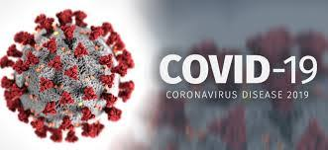
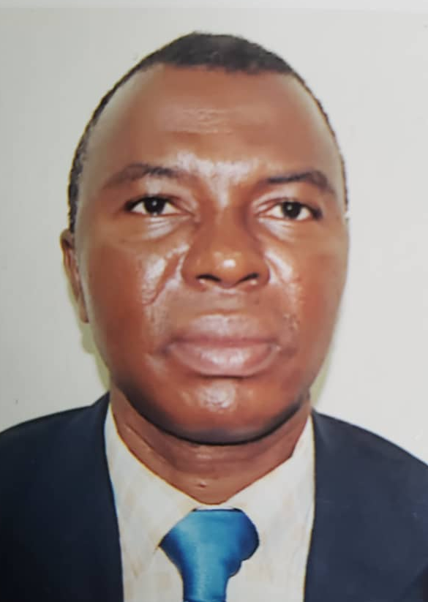
COVID-19: What you should know
Professor Olumuyiwa Odusanya
Director, Research & Innovation
Lagos State University
Image Source: https://www.ecowas.int/

Slide 4
Objective
To provide accurate up-to-date information on COVID-19
Please note ignorance=destruction and disease

Slide 5
Causative Agent
Corona Virus
Have you ever had the Common Cold?

Slide 6
COVID 19 is new
Never occurred in man

Slide 7
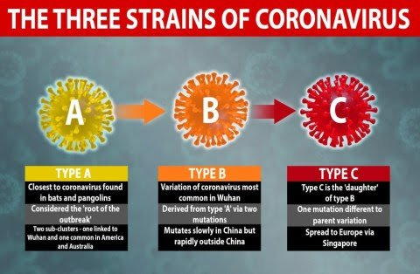
Three Corona virus strains exist globally

Slide 8
What You should Know
Previous corona viruses caused:
Severe acute respiratory syndrome (SARS)
Middle East Respiratory Sydrome (MERS)
Reservoir
Bats (presumed)
Intermediate Host
Uncertain of the animal (Pangolins suggested)
Incubation Period
2-14 days

Slide 9
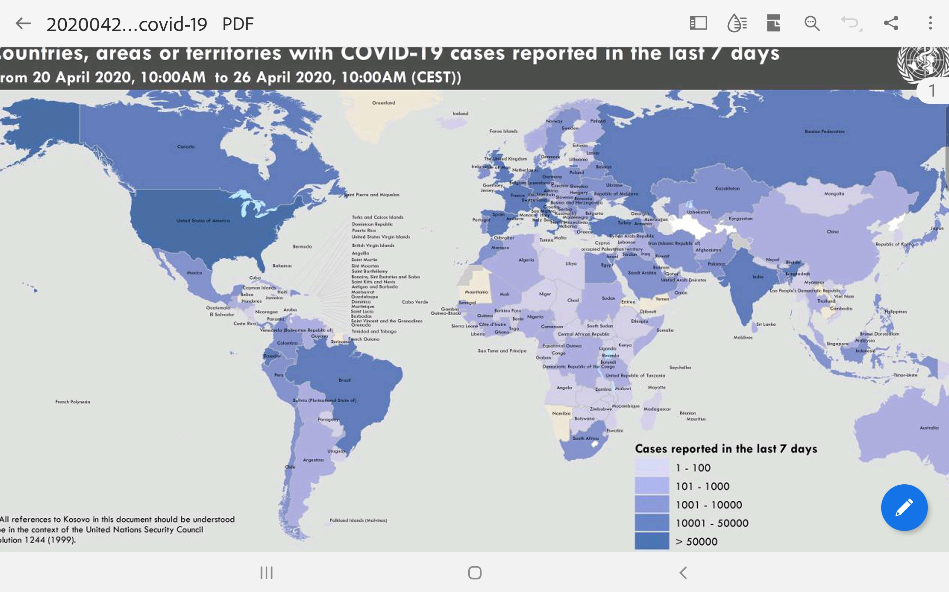
Geographical spread: all over the world (2,804,796 cases)

Slide 10
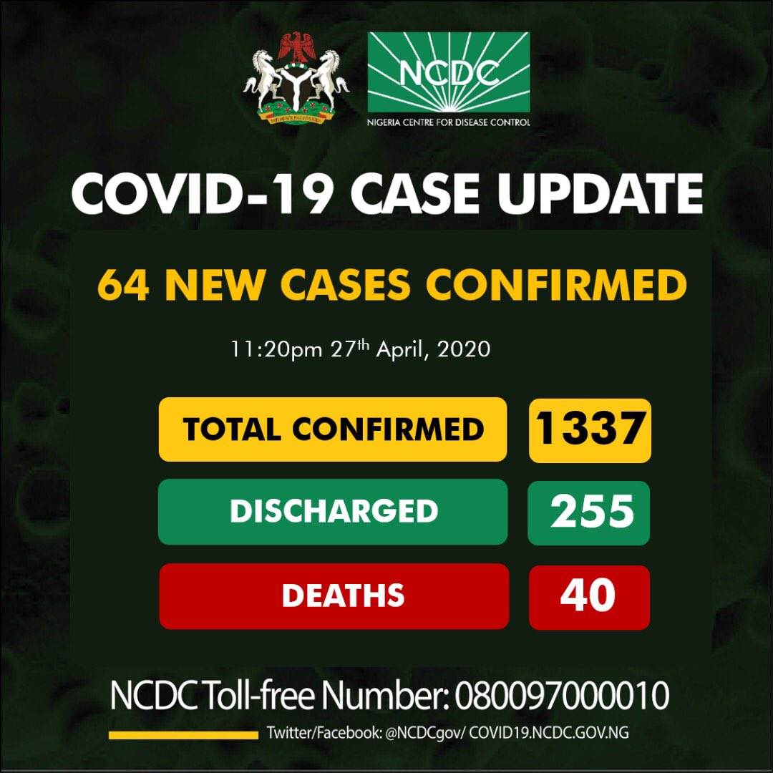
Corona Virus in Nigeria (@ 27th April, 2020)
https://twitter.com/NCDCgov/status/1254745270014926855?ref_src=twsrc%5Etfw%7Ctwcamp%5Eembeddedtimeline%7Ctwterm%5Eprofile%3ANCDCgov&ref_url=https%3A%2F%2Fcovid19.ncdc.gov.ng%2F

Slide 11
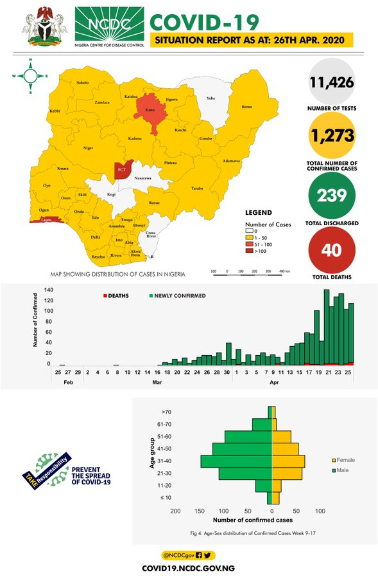
Corona Virus in Nigeria (@ 26th April, 2020)
Samples tested: 11,426
Confirmed cases: 1,273
States affected: 33
Discharged: 239
https://twitter.com/NCDCgov/status/1254745270014926855?ref_src=twsrc%5Etfw%7Ctwcamp%5Eembeddedtimeline%7Ctwterm%5Eprofile%3ANCDCgov&ref_url=https%3A%2F%2Fcovid19.ncdc.gov.ng%2F

Slide 12
Corona Virus in Nigeria (@ 26th April, 2020)
Deaths 40 (3% case fatality rate)
https://twitter.com/NCDCgov/status/1254745270014926855?ref_src=twsrc%5Etfw%7Ctwcamp%5Eembeddedtimeline%7Ctwterm%5Eprofile%3ANCDCgov&ref_url=https%3A%2F%2Fcovid19.ncdc.gov.ng%2F

Slide 13
Corona Virus in Nigeria (@ 26th April, 2020)
Age affected most: 31-40 (21%)
Males 840 (66%)
Female 433 (34%)
https://twitter.com/NCDCgov/status/1254745270014926855?ref_src=twsrc%5Etfw%7Ctwcamp%5Eembeddedtimeline%7Ctwterm%5Eprofile%3ANCDCgov&ref_url=https%3A%2F%2Fcovid19.ncdc.gov.ng%2F

Slide 14
Nigerian Details
History/Source of Infection
Travel 210 (16%)
Contacts 338 (27%)
Unknown 512 (47%)
Incomplete 133 (10%)

Slide 15
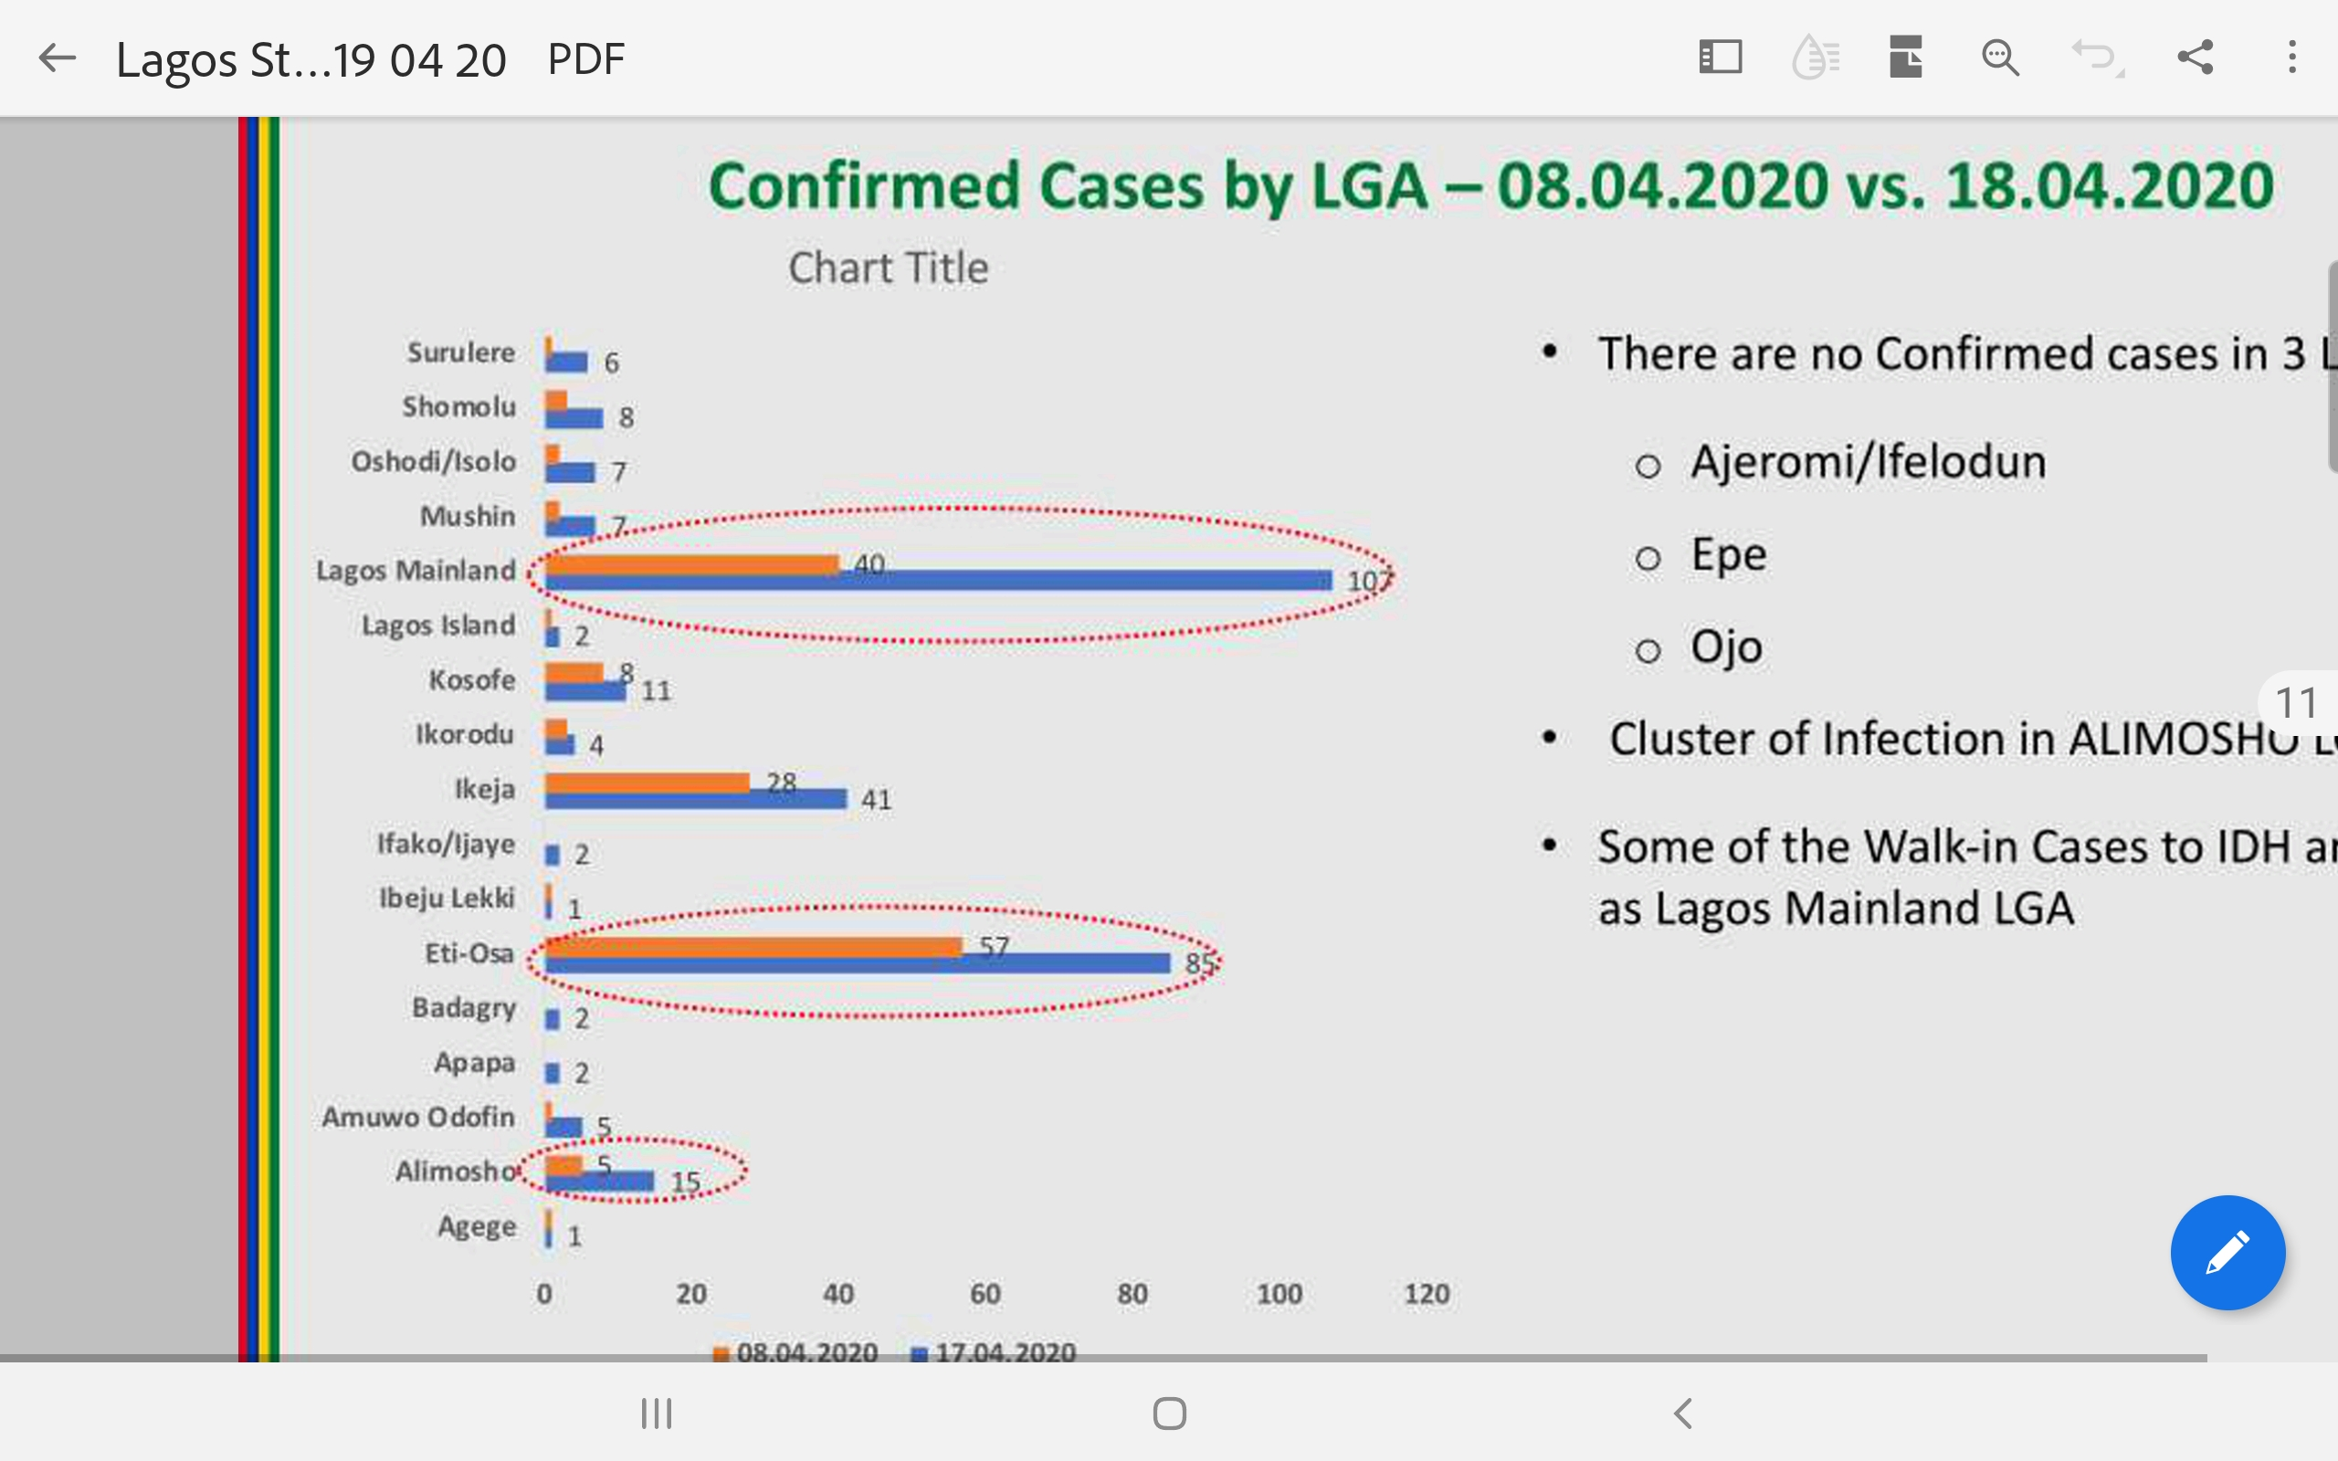
Corona virus in Lagos State

Slide 16
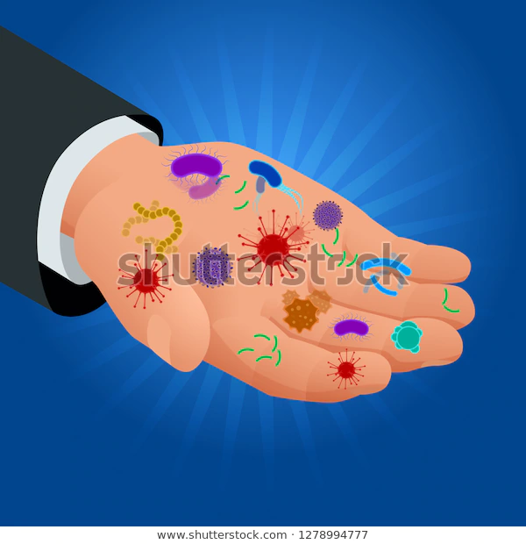


How is the Virus Spread?
Through droplets
Through formites
Touching of contaminated surfaces
Many who are carriers of the virus are not aware they are infected but are able to pass it to others
https://www.shutterstock.com/search/spreading+disease

Slide 17
Symptoms
Dry cough
Shortness of breath
Fever
Sore throat
Inability to smell things properly
Fatigue
Tiredness

Slide 18
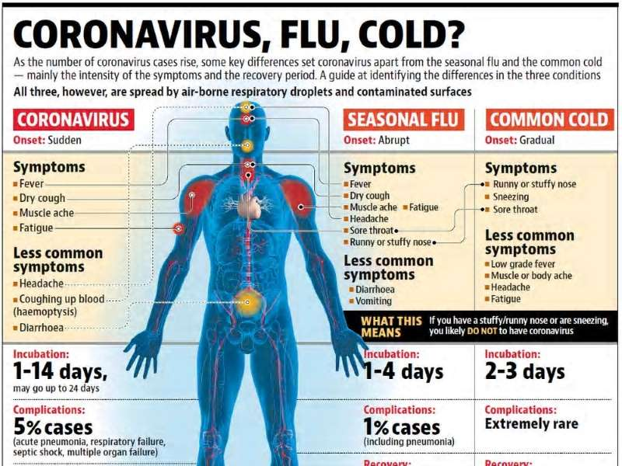
All fever and cough may not be due to harmless corona virus

Slide 19
Is there any Definitive Treatment?
None
No drugs yet
No vaccines
Supportive treatment
Rehydration
Medicines for fever
Medicines to prevent secondary bacterial infection

Slide 20
Corona Infection:
What you should know…
Many people will not develop symptoms
Only a small number will become acutely ill needing care
Most of those ill will recover
Problems are worse in elderly and those with underlying medical problems such as diabetes
It is not a death sentence

Slide 21
Some Harmful Steps to Avoid
Use of chloroquine or other medicines without prescription
Travelling from state to state
Refusal to stay at home
Receiving fake vaccines
Spreading fake news
Hiding medical history of travel
Use of unverified herbal medicines

Slide 22
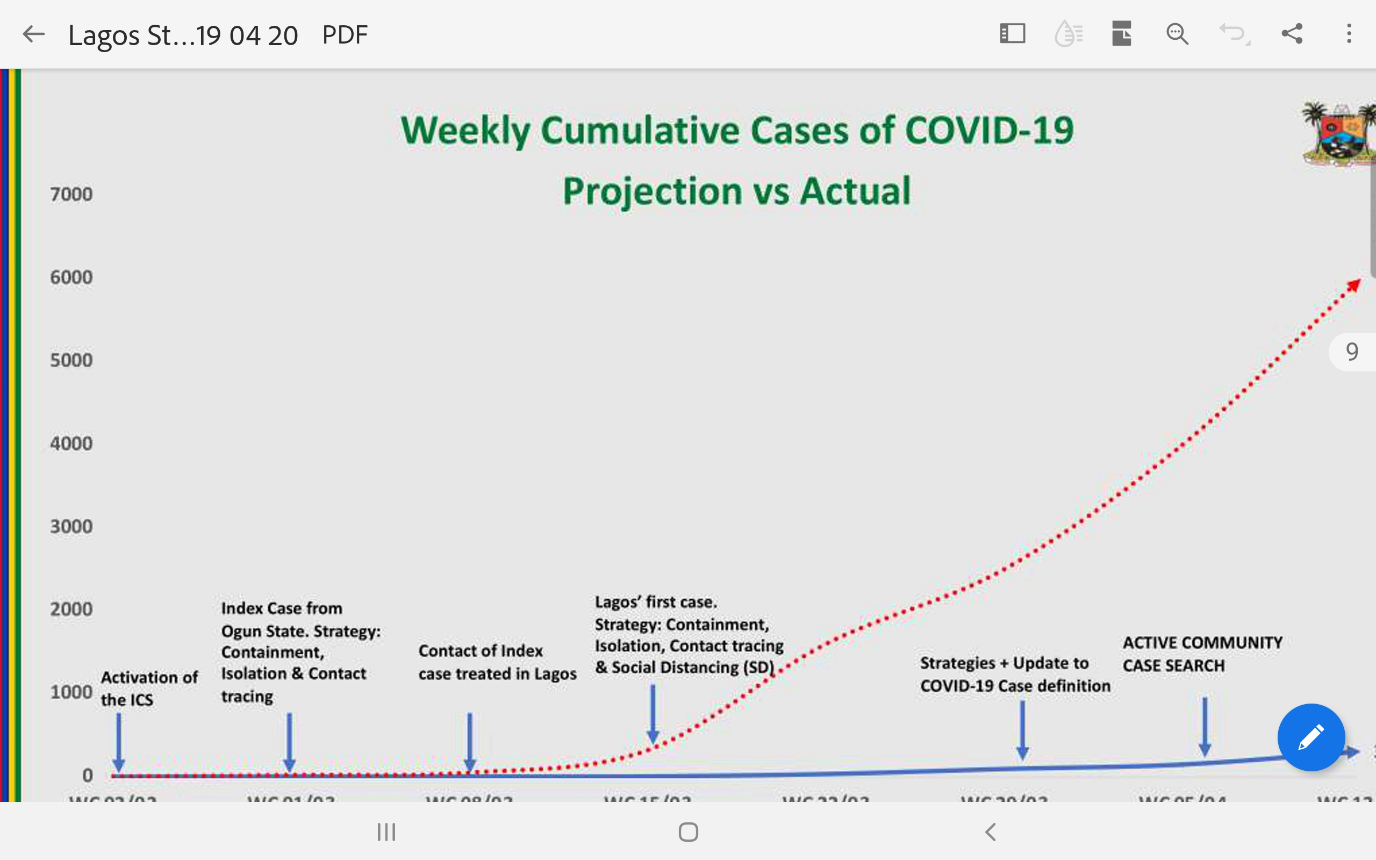
Flattening the curve in Lagos State

Slide 23
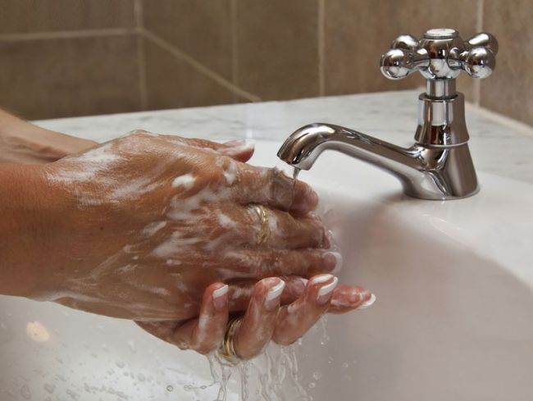

Prevention
Wash hands with soap under running water for 20 seconds
Use of Alcohol–based Hand Sanitizers
https://www.livescience.com/57044-science-of-soap.html
https://www.signsonline.ie/products/please-use-hand-sanitiser

Slide 24
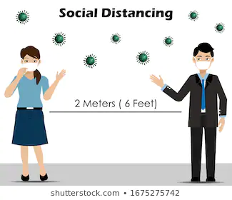

Prevention
Social Distancing
Avoid Large Crowds
https://www.shutterstock.com/search/social+distancing

Slide 25
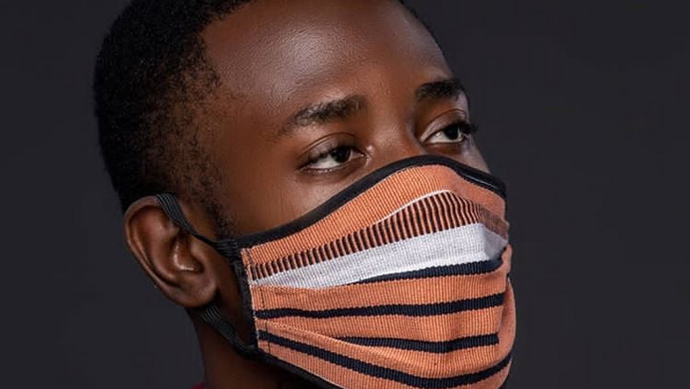
Prevention
Use of face masks when in the public
https://www.pulse.com.gh/lifestyle/beauty-health/5-right-ways-to-use-nose-masks-for-protection-against-coronavirus-according-to-the/14nz0e3

Slide 26
Contact Numbers
Lagos State: 08000-CORONA
NCDC: 0800-970-000-10

Slide 27


